Slide 1



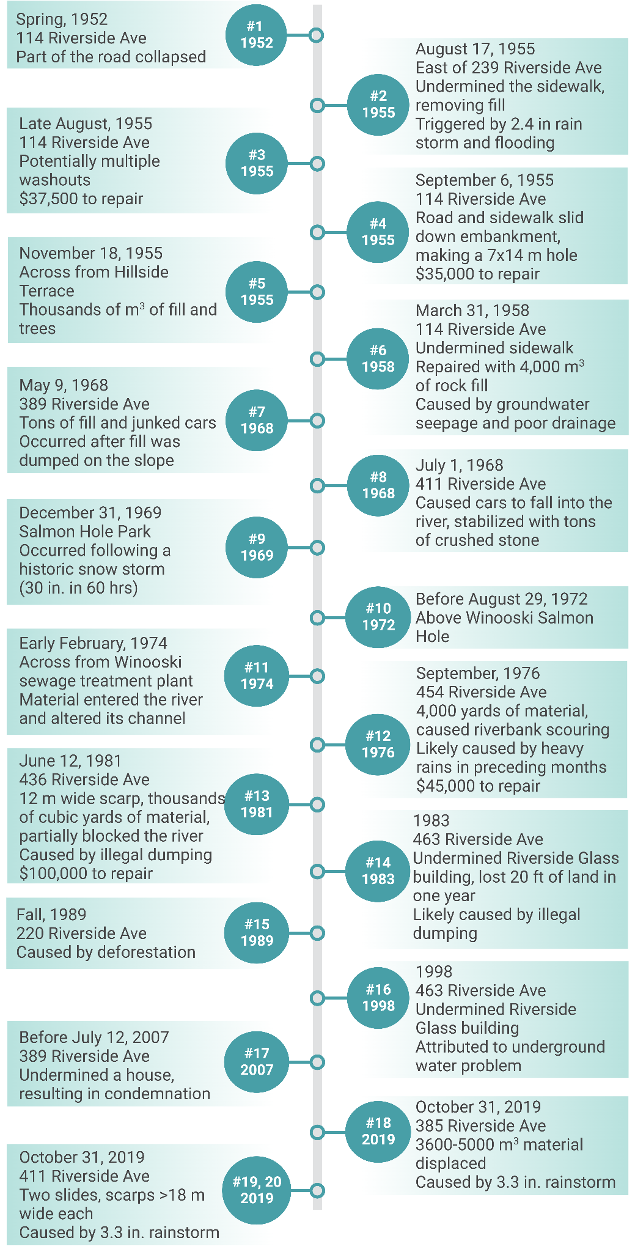
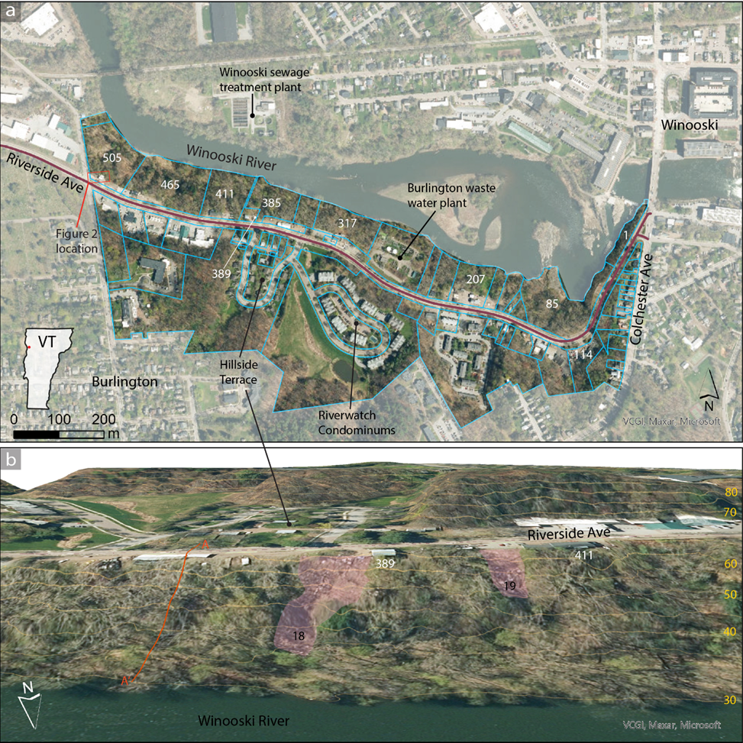
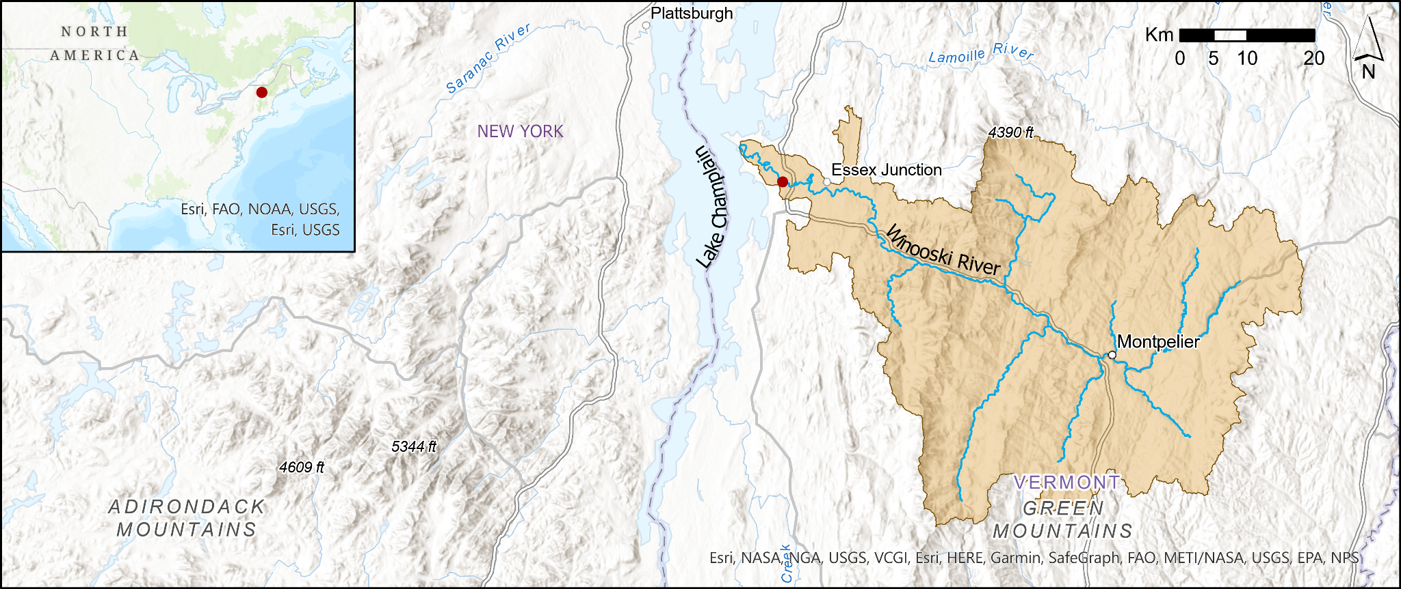
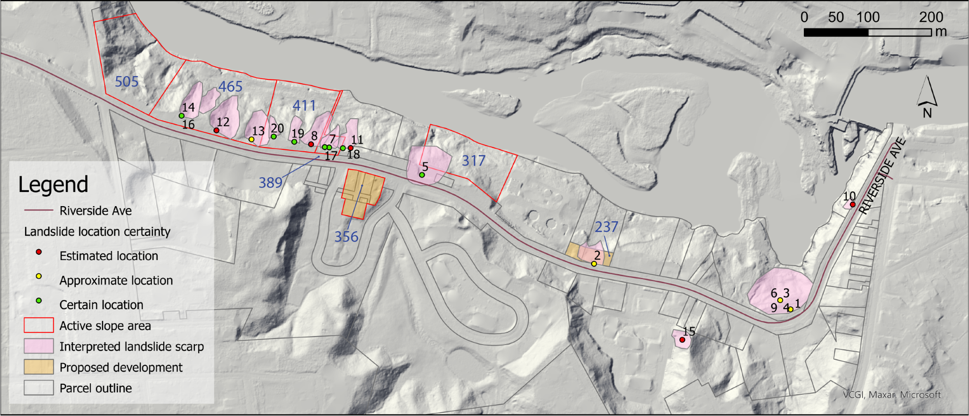
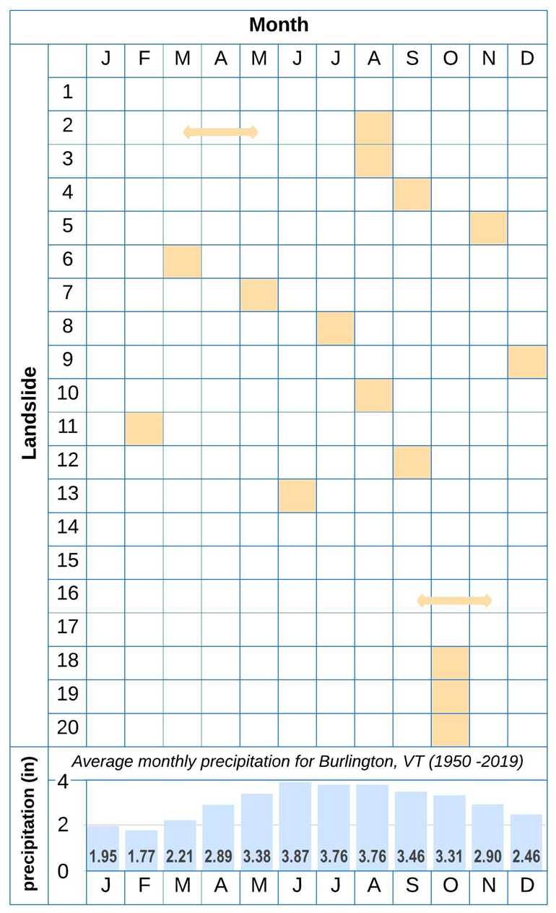
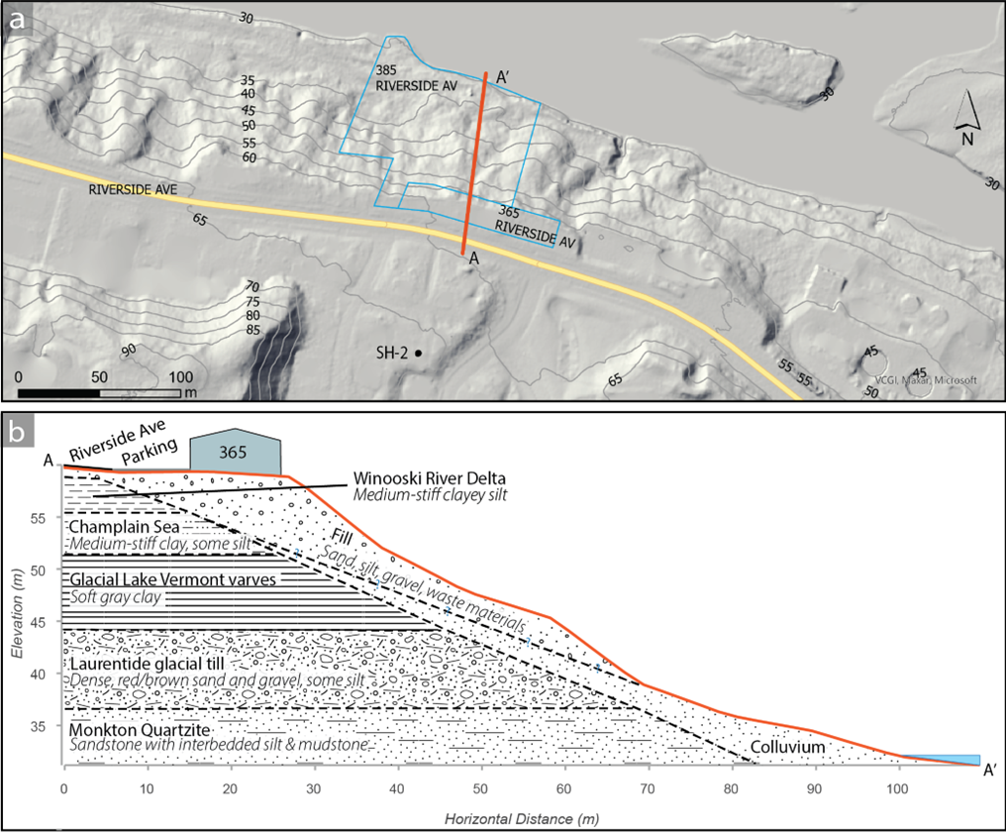
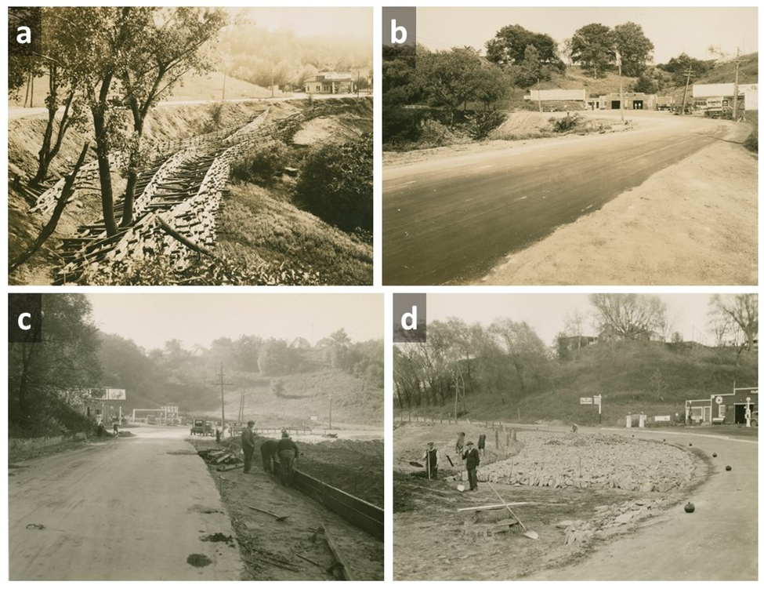
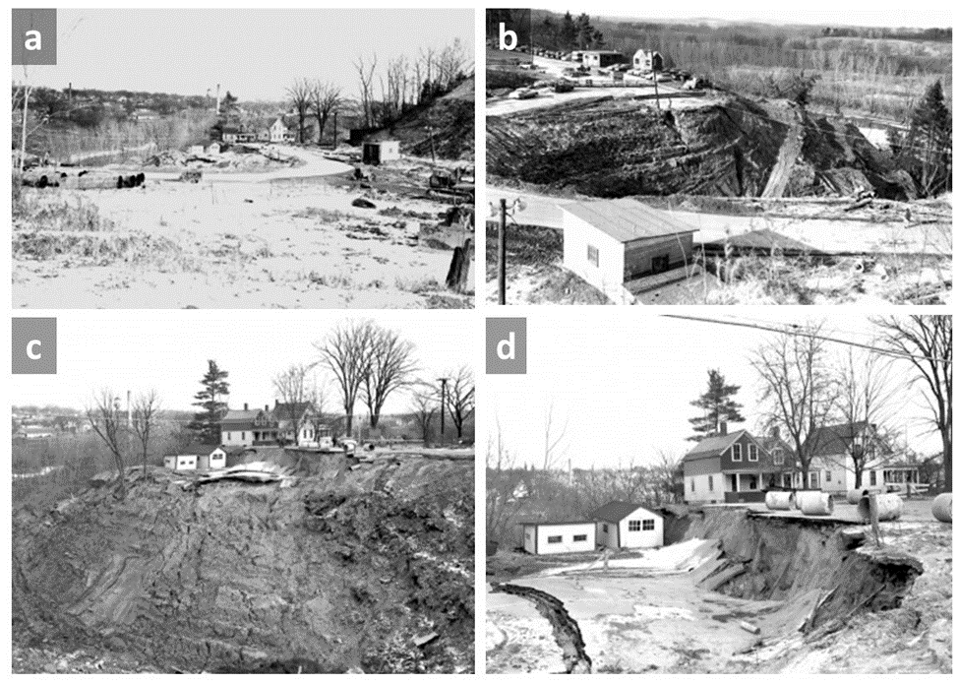
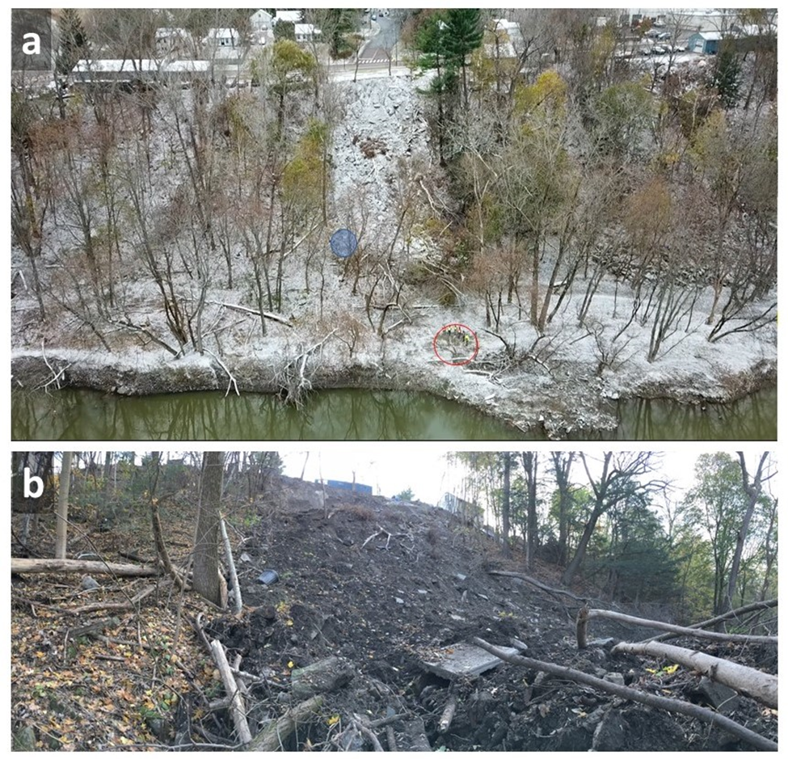
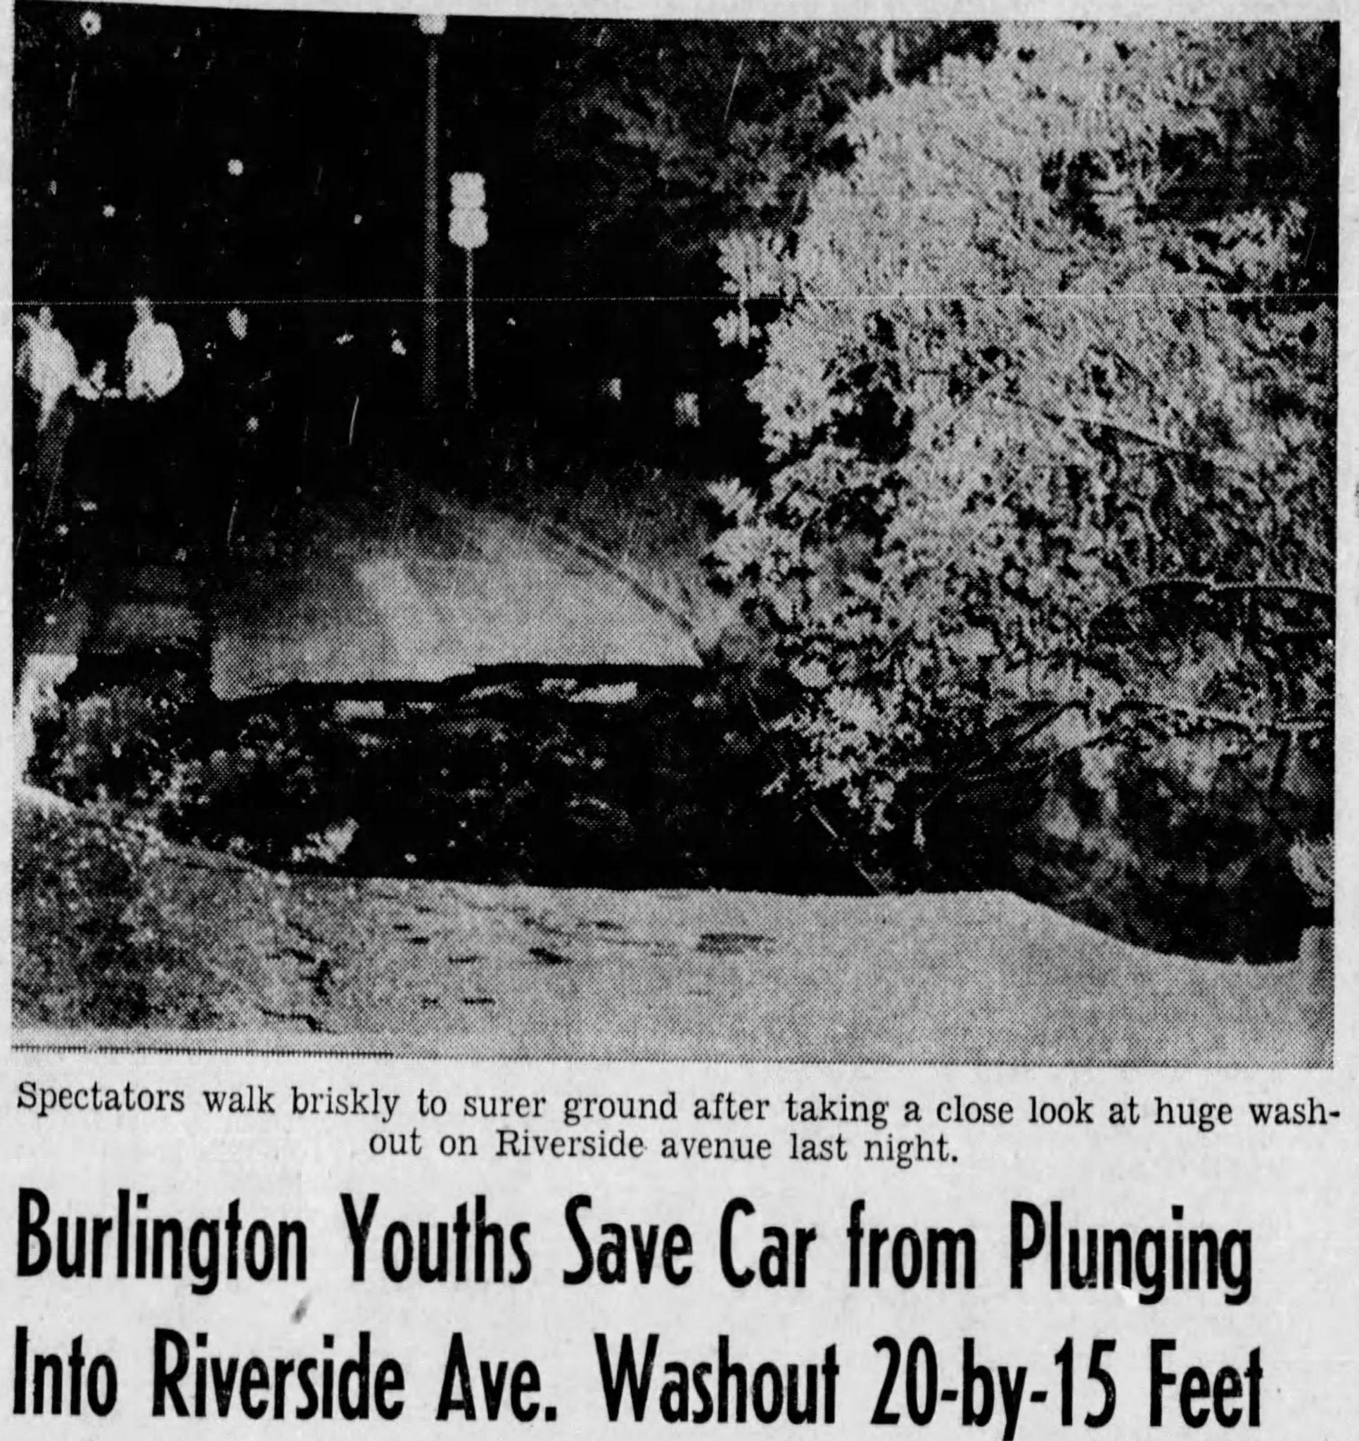
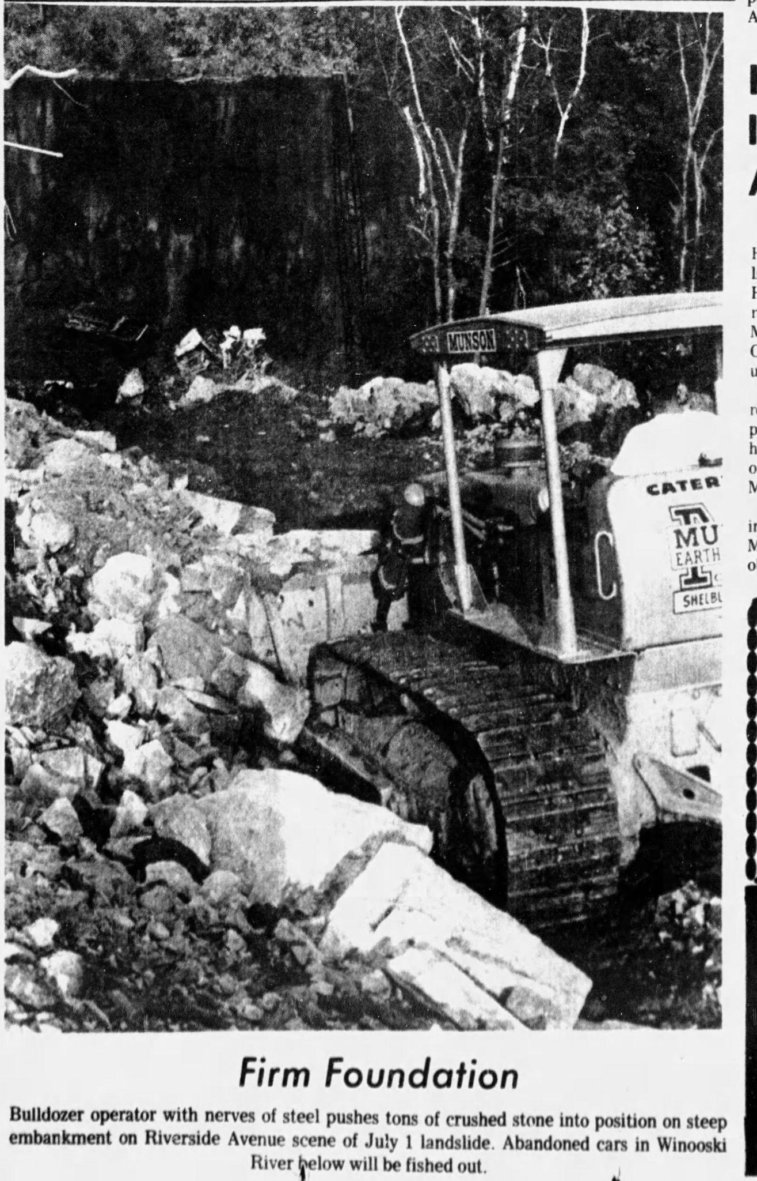
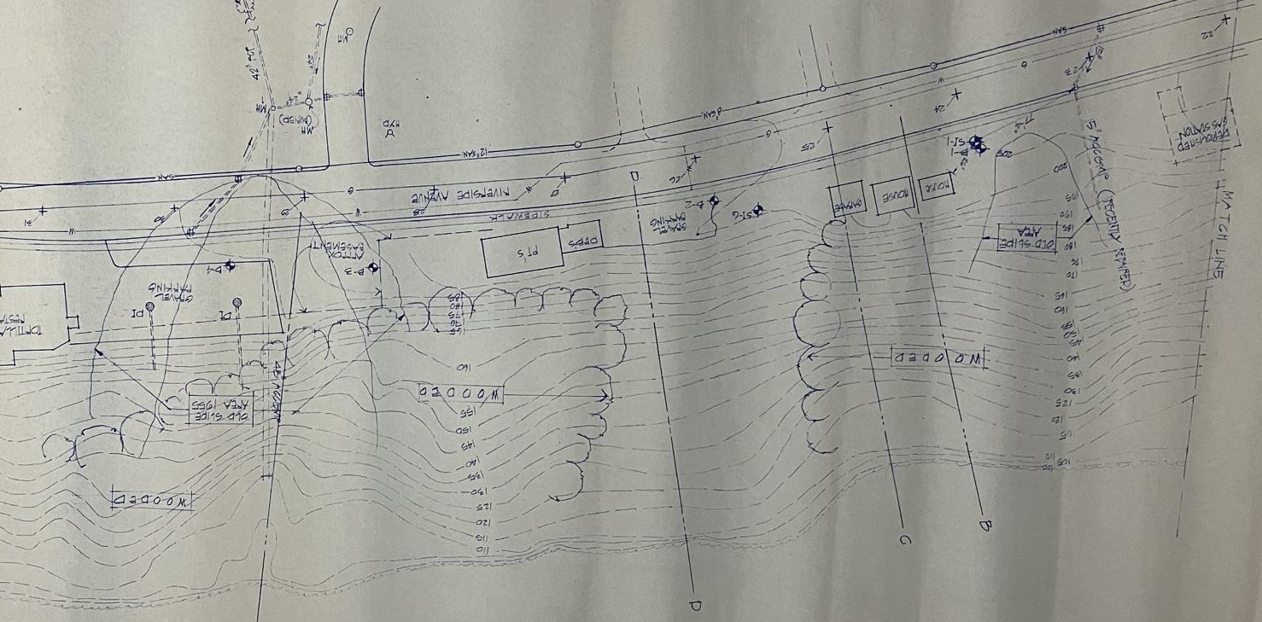
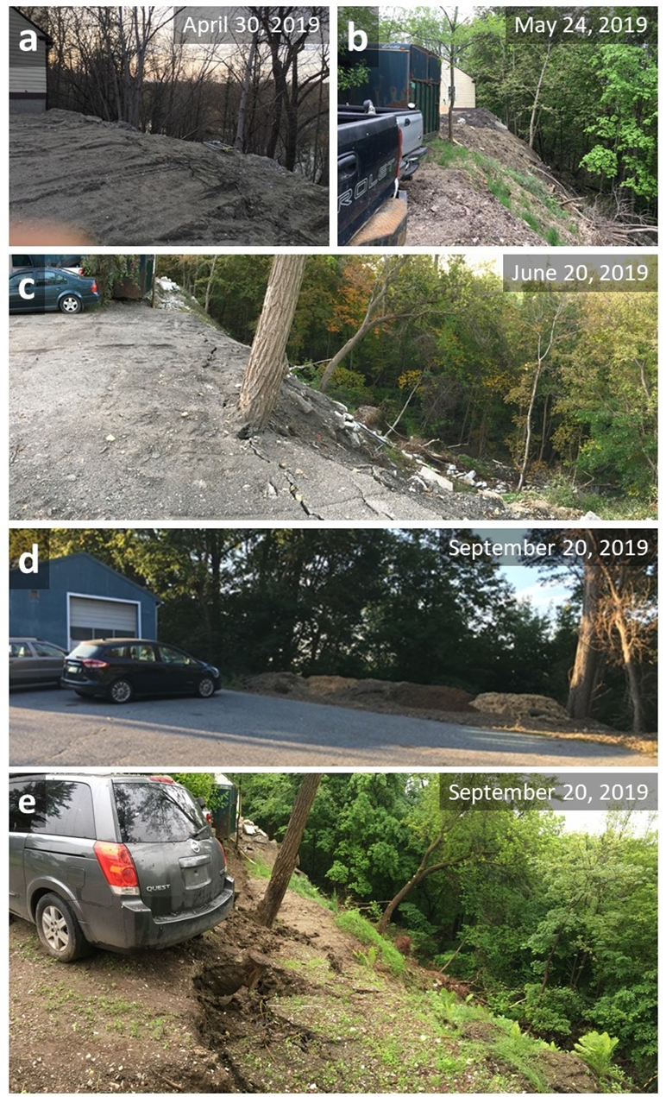
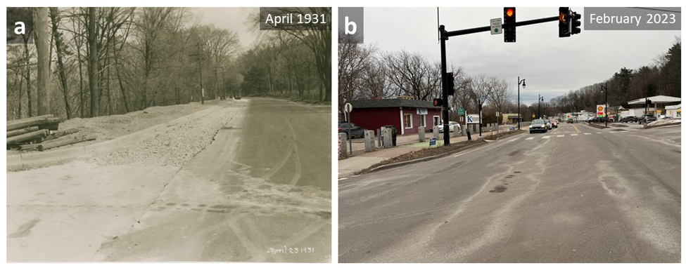
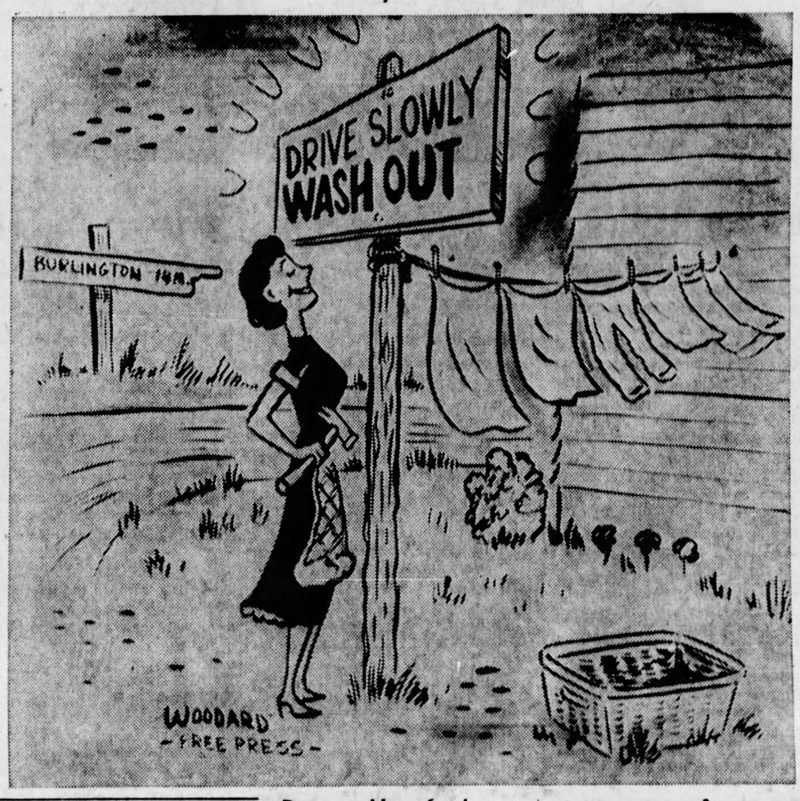

Decades of Dumping Unconsolidated Fill Along a Steep Urban Slope Drive Recurring Landslides
Isabella Bennett & Paul Bierman
Gund Institute for Environment & Rubenstein School for Environment and Natural Resources, University of Vermont
EP11D-1777: Drivers of Earth's Surface Change in an Era of Rapid Climate and Land Use Change
Introduction
Findings
Landslide timeline
We investigated the recorded history of a 1.4 km stretch of highway in Burlington, Vermont to quantify landslide occurrence along the adjacent slope, evaluate causality, and identify spatial and temporal patterns within the publically available data. This slope formed as the result of river incision into successive layers of Laurentide glacial deposits over the past ~14,000 years. In the past century, this slope has been altered formally and informally to support growing population and infrastructure. These changes have impacted slope stability.
Road widening began in the late 1920s, followed by informal fill emplacement to expand buildable area
20 landslides have occurred between 1952 and today (recurrence interval of 3.4 years)
Landslide causes: destabilization by dumping of fill, extreme precipitation events, underdrain leakage & deforestation
Seasonal patterns likely driven by climate and vegetation, spatial distribution highlights patterns of recurrence
Location map showing northern New York and Vermont, with the the Winooski River watershed (tan) and major tributaries (teal). Field area marked with a red dot.
Map showing the spatial relationships between important features along Riverside Ave including landslide locations (sorted by certainty), interpreted scarps, properties designated as active slope areas in 2020, and the locations of two >64 unit apartment complexes proposed in 2021.
Distribution of landslides by month. Numbers correspond to timeline & map.
100 years of slope alteration to expand buildable area reduced slope stability, resulting in 20 landslides
Riverside Ave is an important state highway that connects Burlington, Vermont to the neighboring city of Winooski. (a) highlights several locations (black text) and addresses of interest along Riverside ave (white text). (b) provides a 3D view of Riverside Ave as seen from across the river. Landslides #18 & 19 are visible, as is profile A-A’.
Using data from borehole SH-2 (a) and local stratigraphic descriptions, we developed a schematic cross section of the slope at 365 Riverside Ave (Sanborne, Head & Associates Inc. 2021; Wright n.d.). (a) Shows a bare earth DEM, 5 meter contour lines, and profile A-A’. Material descriptions (b) are synthesized from Sanborne, Head & Associates Inc. (2021).
Methods
1931 Photographs of roadside expansion at 114 Riverside Ave using wooden cribbing and fill (UVM SS Collection)
Photographs of the November 18, 1955 landslide (UVM SS Collection)
Images of the 2019 landslide taken from above (a), and from the base of the landslide (b)
Systematic archival newspaper search
2. Data collection through public records
3. Landscape observation & monitoring
Implications
Where do we go from here?
Historic records can provide insight into hazard occurrences and land use and change over time, which can help inform geomorphic research
Public records and historic imagery can provide context for environmental issues at the local level
Previously emplaced slope stabilization interventions have been costly and environmentally invasive - large boulders proved most successful
In the context of Vermont’s changing climate, more frequent high intensity rain events are expected to exacerbate mass movements
Disallow future development along this slope to avoid increased overburden
Remove existing structures through FEMA property acquisitions where possible
Replace buildings and impermeable surfaces with native vegetation with dense root mass to increase root cohesion
Transition the river adjacent slope into a public green space with engineered stormwater removal
Investigate the history of local hazards where possible to better inform hazard management and prepare for increasingly variable climate conditions
4. Rephotography to assess change over time
5. Spatial analysis in ArcGIS
Acknowledgements
Image sources
Burlington Free Press
Burlington DPW
Photos by P. Bierman
We thank Adam Zylka, Jarlath O’Neil-Dunne, Thomas Visser, Christopher Halsted, previous UVM students Kestrel Owens, Mark Hehlen and Jason Drebber, all members of the UVM 2020 Geomorphology class, the Gund Institute for Environment, and the Burlington Department of Public Works.
References
4. (a) UVM SS Collections
(b) I. Bennett
5. Burlington Free Press

